Slide 1
Power BI Development
Cycle
Power BI Development
Cycle

Slide 2
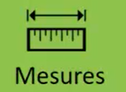



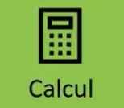







Power BI Development Phase
Phase1
Phase 2
Phase 3
Phase 4
Phase 5
Phase 2

Slide 3
Thank you
Thank you

